Slide 1
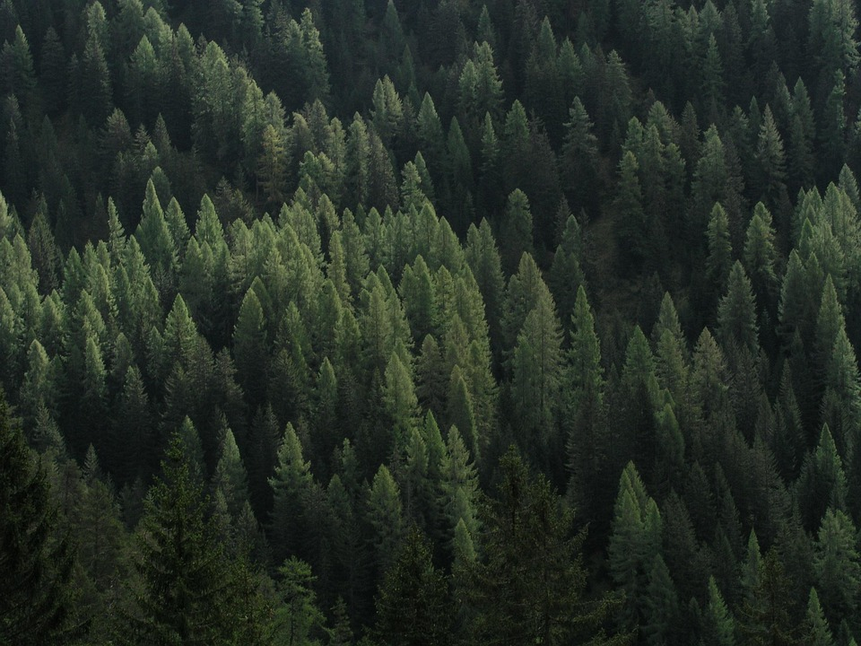
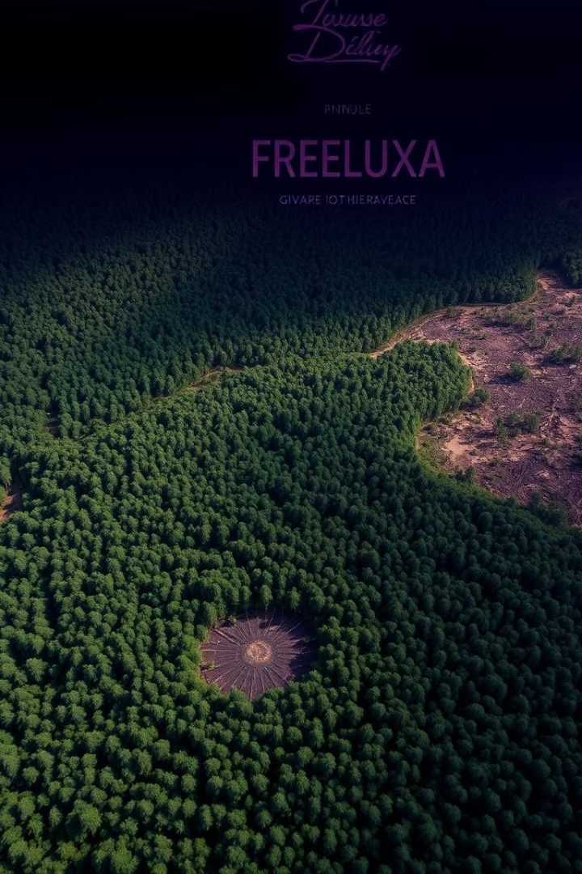
Deforestation: A Global Crisis
Deforestation is a critical global issue. The current rate is approximately 10 million hectares each year. Urgent action is required now to safeguard our forests.
PRESENTED BY:
AAKASH VASHIST & ABHISHEK NEGI
MSC. COMPUTER SCIENCE (COHORT 2025)
SUBJECT: TOOLS & METHODS OF DATA ANALYSIS

Slide 2

Agenda
Introduction
Causes of Deforestation
Logging
Agriculture
Ecological Consequences
Urbanization
Comparison : 1950 vs 2005
Prevention Strategies
Resources

Slide 3
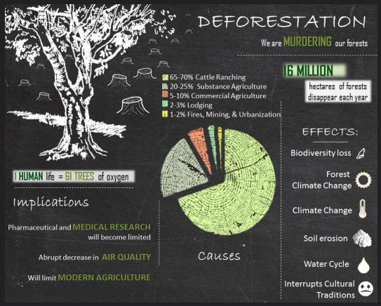
Understanding Deforestation
Deforestation is the clearing of forests for other land uses. Forests cover 31% of the Earth’s land surface. Since 1990, we've lost 178 million hectares of forest.
Land Conversion
Forest Coverage
Global Impact
Changing forest areas for agriculture, urban areas, and more.
Forests once covered a significantly larger portion of the Earth.
Deforestation affects global climate patterns and ecosystems.

Slide 4
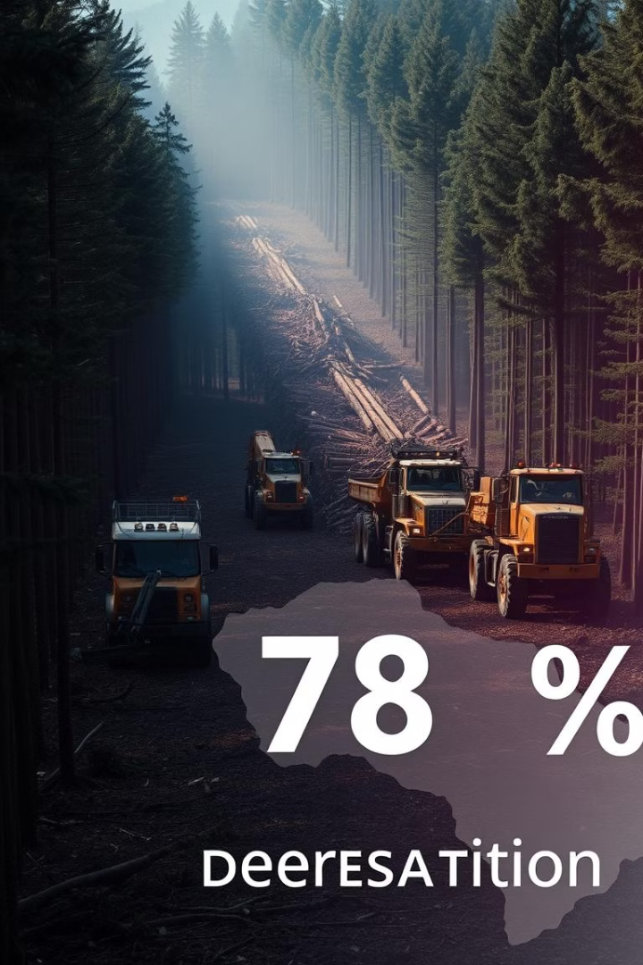
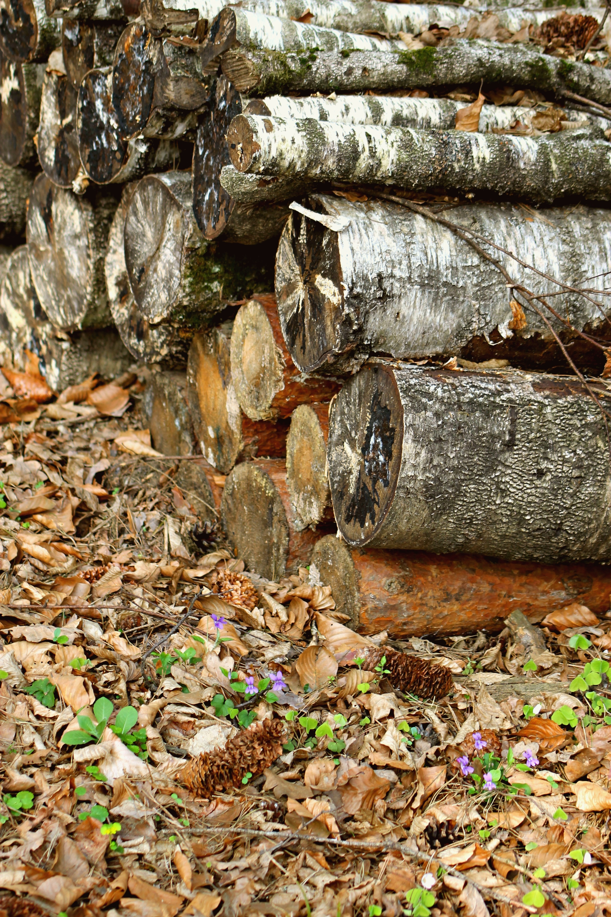


The Impact of Logging Operations
Logging is responsible for ~15% of deforestation globally. This includes both legal and illegal logging activities. The impact includes habitat destruction and soil erosion.
Habitat Destruction
Forests are vital for various species' survival.
Soil Erosion
Logging can significantly degrade the quality of the soil.

Slide 5
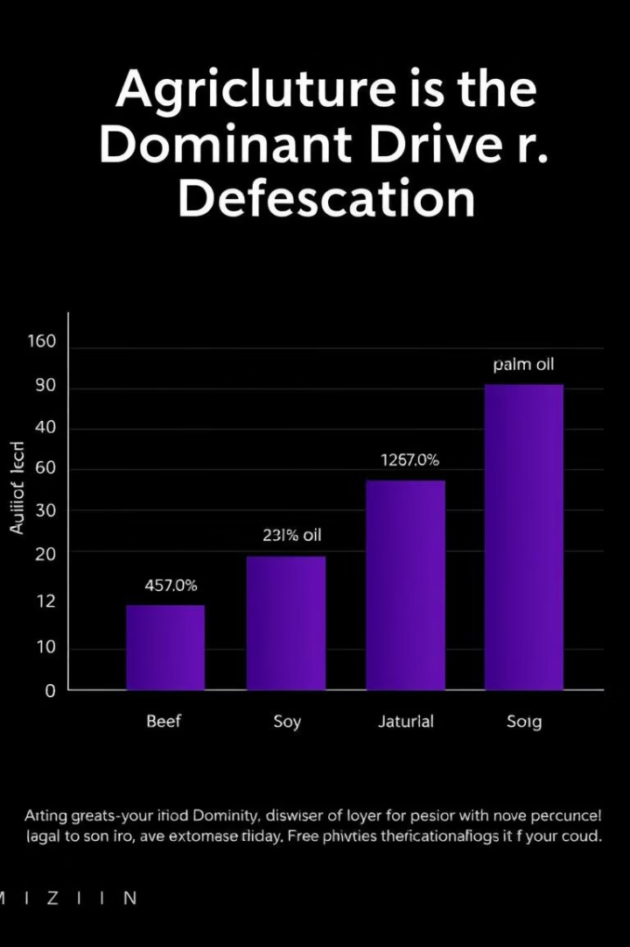
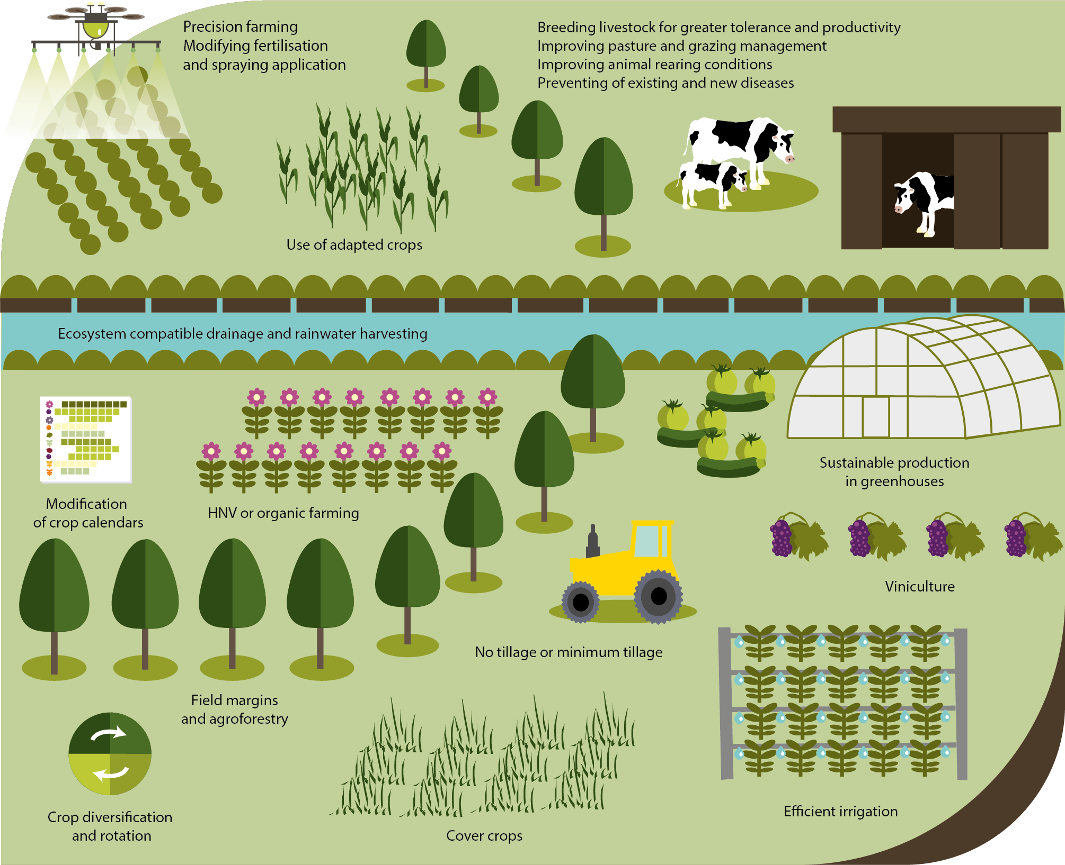



Agriculture: A Leading Cause
Agriculture accounts for approximately 80% of global deforestation. High demand for beef, soy, and palm oil are major factors. The Amazon rainforest has been cleared for cattle ranching.
Beef Demand
Soy Production
Palm Oil

Slide 6
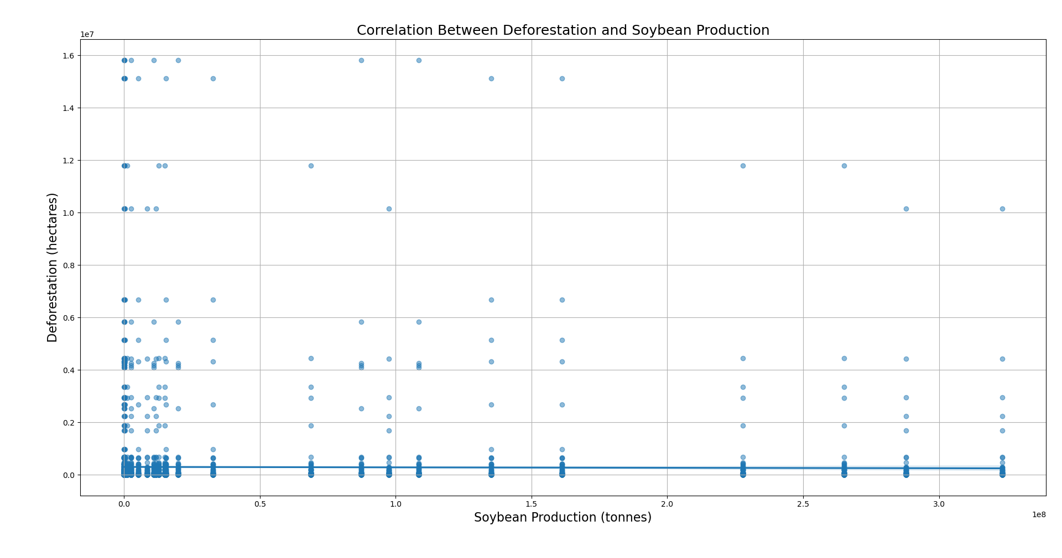
Correlation b/w Deforestation &: Agriculture
Fig 3.

Slide 7
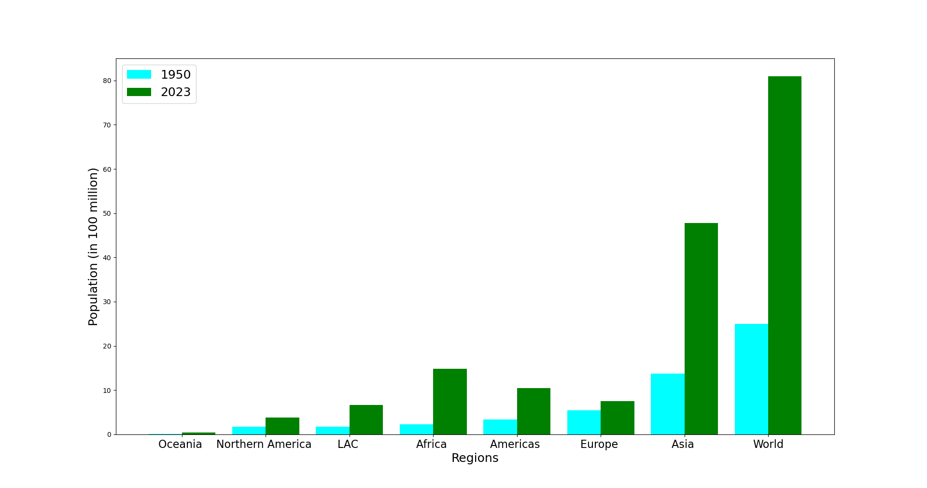
Urbanization : Major Cause
Forests are home to 80% of terrestrial biodiversity.
Deforestation contributes ~10% of global emissions. It leads to soil erosion and water cycle disruption.
Fig 1.

Slide 8
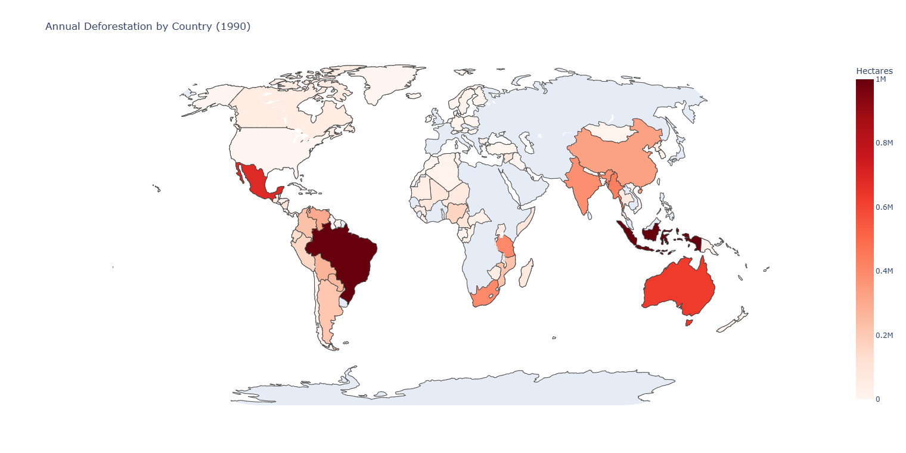
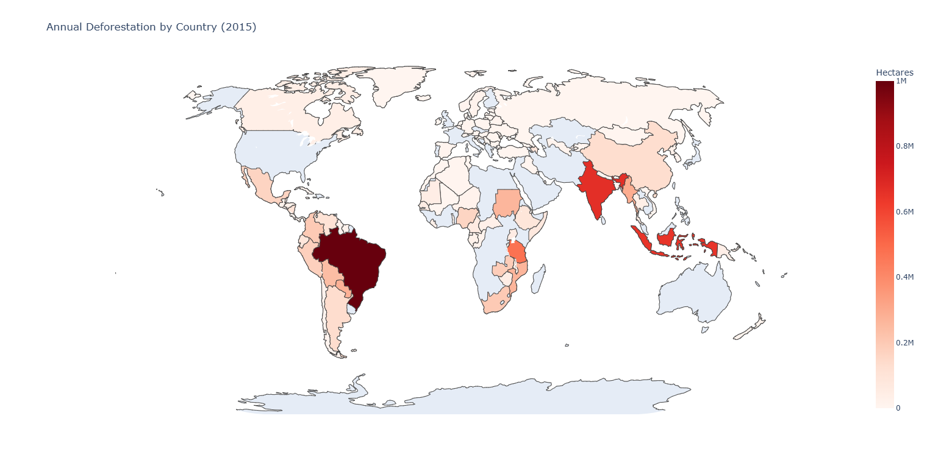
Comparison : 1990 vs 2015
Fig 3.

Slide 9






Ecological Consequences
Forests are home to 80% of terrestrial biodiversity.
Deforestation contributes ~10% of global emissions. It leads to soil erosion and water cycle disruption.
Climate Change
Biodiversity Loss
Water Disruption

Slide 10
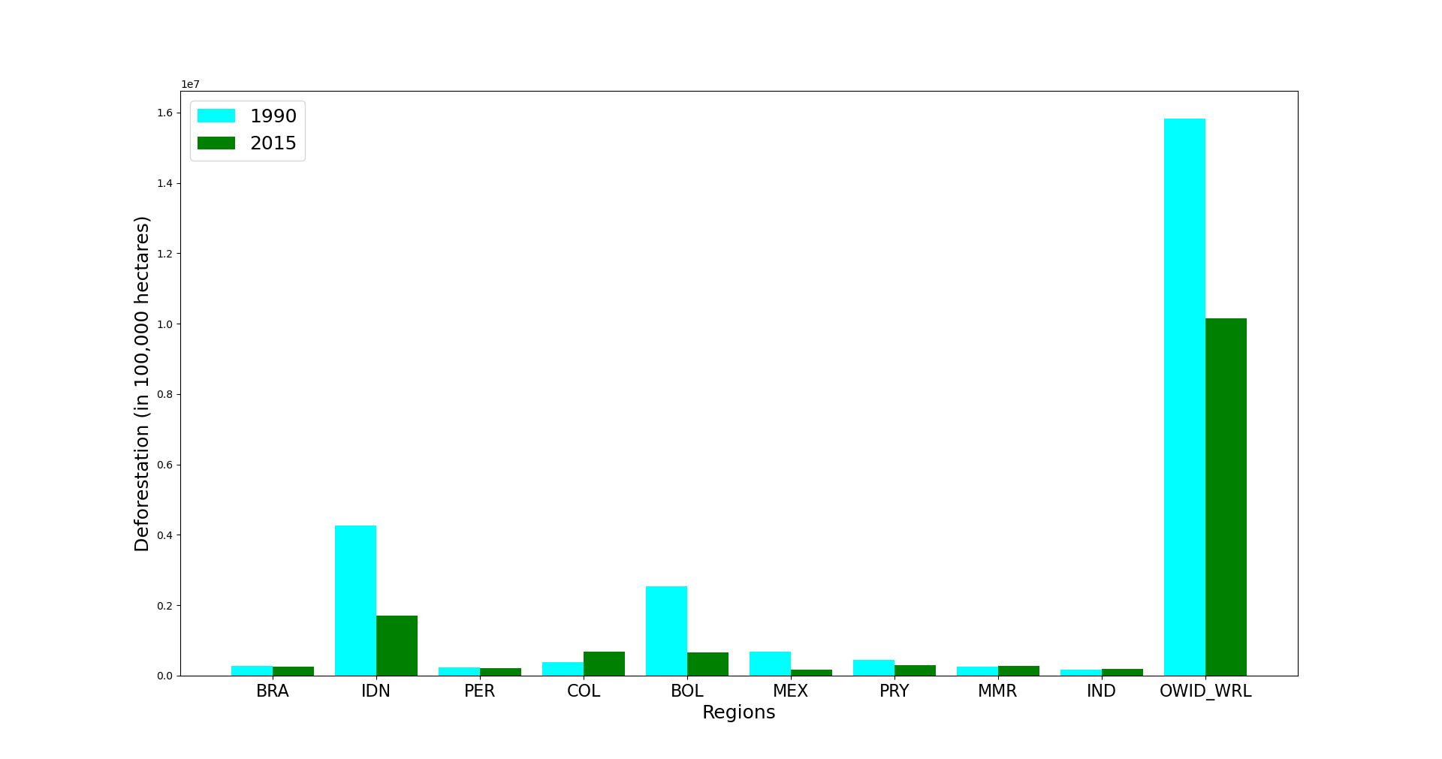
Top Countries suffering from Deforestation
Fig 2.

Slide 11
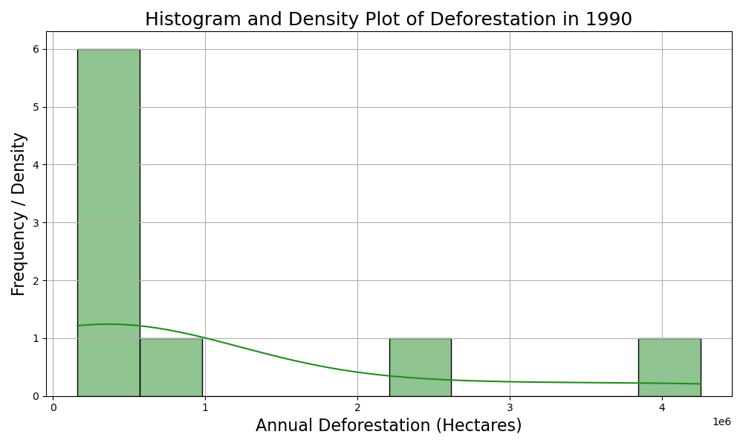
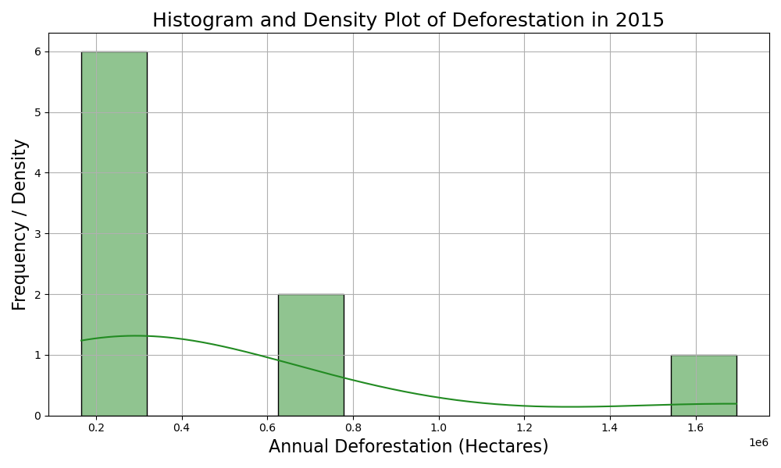
Histogram Comparison: 1990 vs 2015
Fig 3.

Slide 12
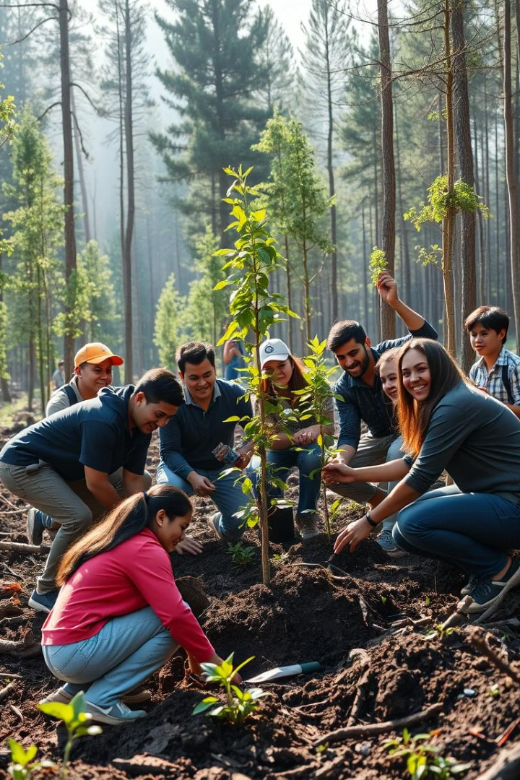



Actionable steps to
Prevent Deforestation
Support
Advocate
Use Sustainable products
Enforce Strong Forest Laws
Donate
For Preservation & Conversation

Slide 13
Sources
Data Collection : https://ourworldindata.org/population-growth
Fig 1. Urbanization: 1950 vs 2023
Fig 2. Top 10 countries suffering from the deforestation
Fig 3. Comparison of deforestation : 1990 vs 2015

Slide 14

Thank
You!!

